Slide 1

EE1002
Introduction to Circuits and Systems
Equipment Demo
Function Generator & Oscilloscope

Slide 2
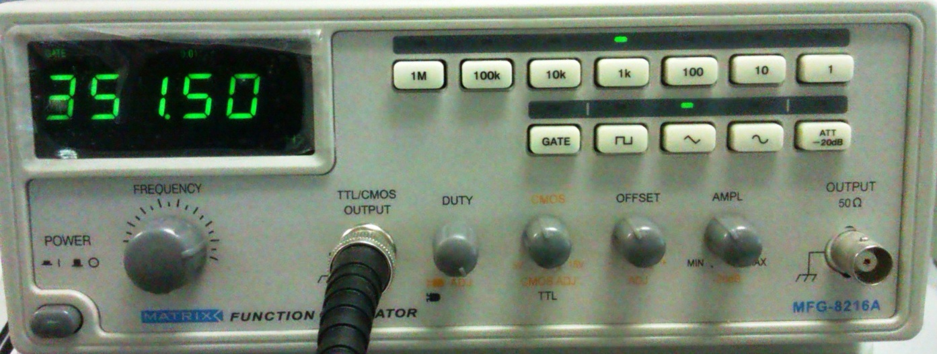
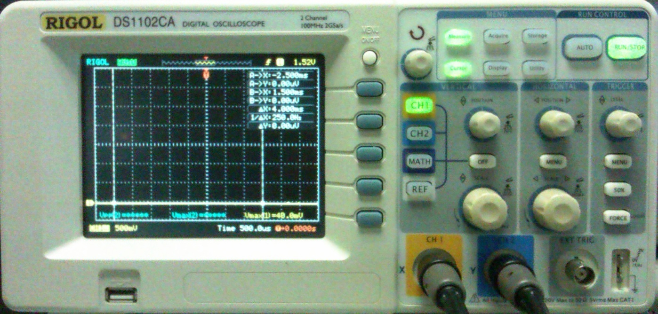

Equipments Involved
Function Generator
Oscilloscope

Slide 3


Function Generator
Output Ports
TTL/CMOS output: square wave
TTL: fixed 0V to 5V
CMOS: 0V to adjustable max value
Normal output

Slide 4

Function Generator
Signal Types (normal output only)
Square wave
Triangular wave
Sinusoidal wave

Slide 5

Function Generator
Parameter Knobs
Frequency (all)
Duty cycle (all)
CMOS amp (CMOS only)
Offset (normal only)
Amplitude (normal only)

Slide 6

Function Generator
Parameter Knobs
Labeled in black: direct adjust
Frequency / Amplitude
Labeled in orange: pull up to adjust
Duty cycle / CMOS / Offset

Slide 7

Function Generator
Scale Buttons
1Hz to 1MHz : Range of frequencies.
Output Frequency : Note that the unit is in the bottom right hand corner of the small screen.

Slide 8
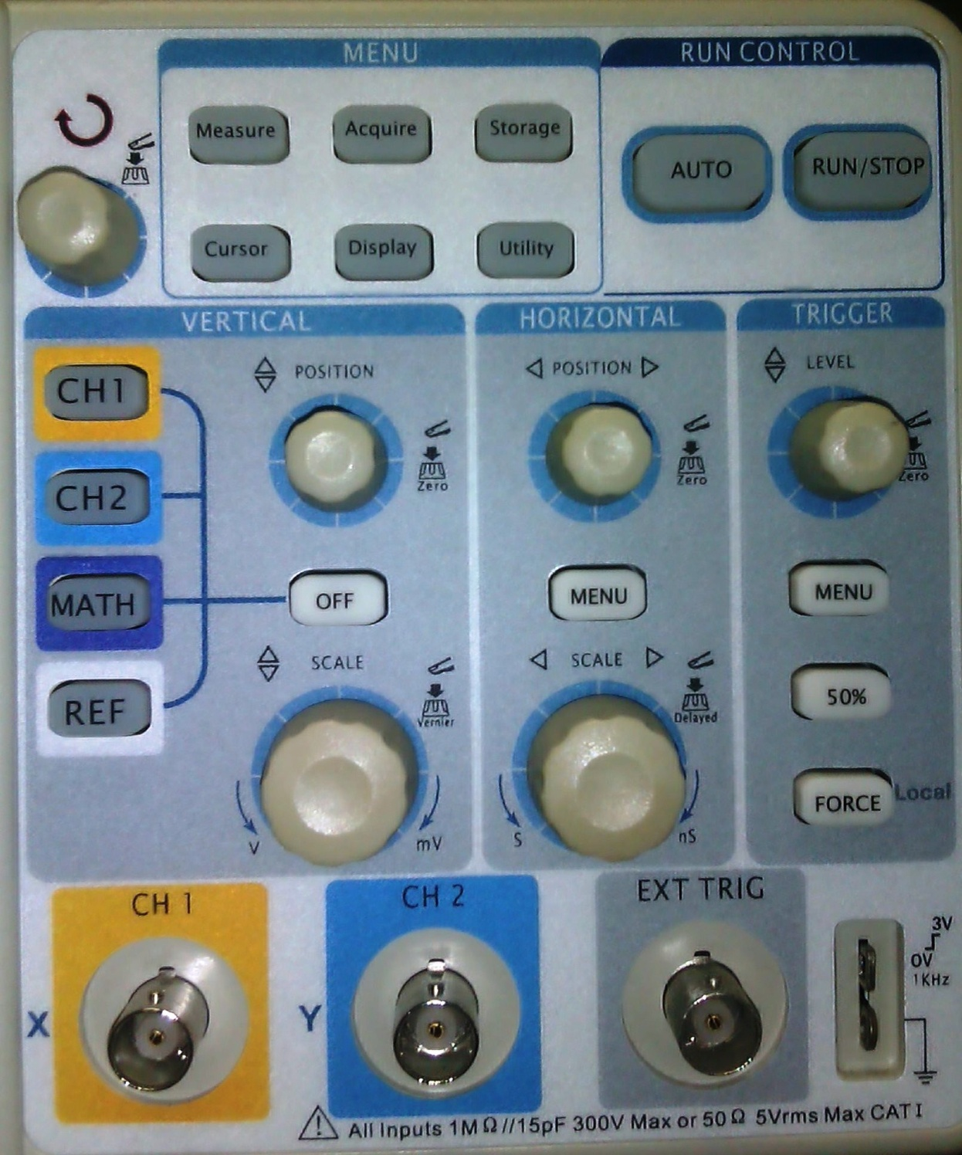
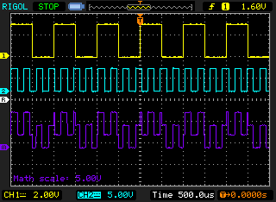

Oscilloscope
Channel Buttons
CH1 (yellow)
CH2 (blue)
MATH (purple)
REF (white)

Slide 9
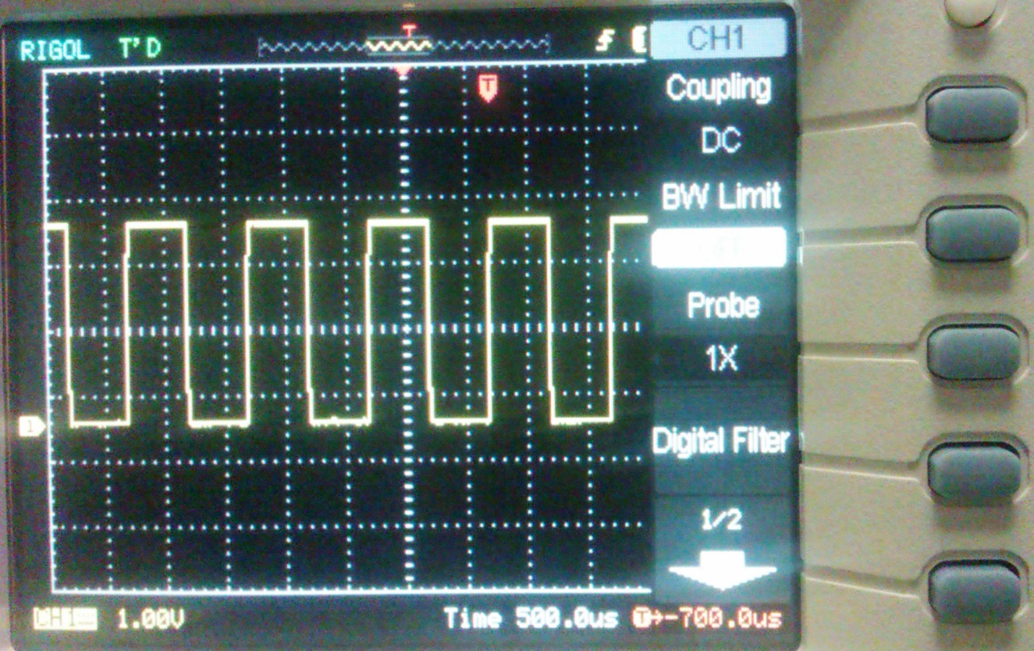

Oscilloscope
Channel Menu
Coupling
DC: pass DC & AC
AC: block DC
BW Limit
Choose OFF
Probe
Choose 1x
Digital filter
Choose OFF
Page 2
Default
Notes:
Select Mode as edge triggered; select input channel as the source; select slope as rising edge,

Slide 10

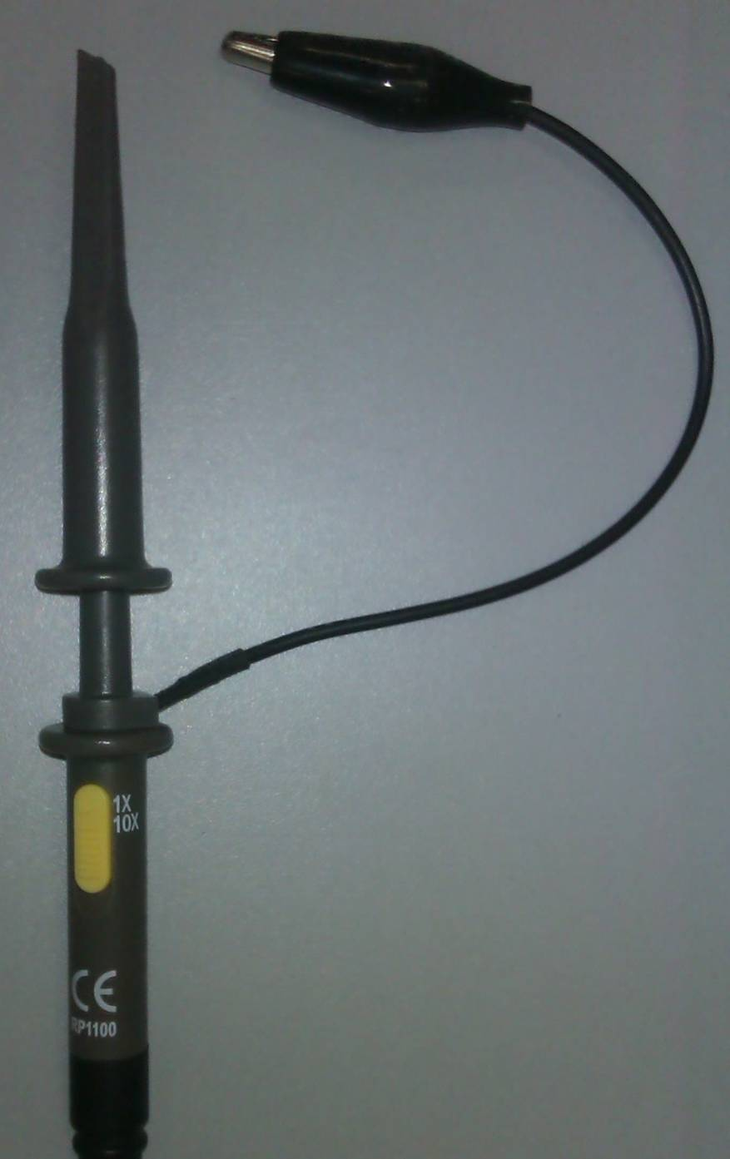

Oscilloscope Probe
Two Ports
Positive
Negative
Hint: the negative terminals of both channels are connected commonly to GND
Attenuation Factor
Please push the button and choose 1x (not 10x)

Slide 11
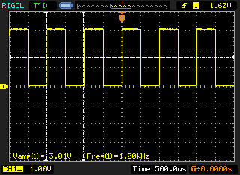

Oscilloscope
Test Signal
To test the probes
0V-3V 1KHz
square wave

Slide 12
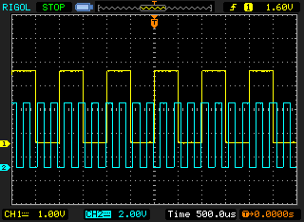

Oscilloscope
Scale Knobs
Vertical scales (volt/div)
Horizontal scales (time/div)
Select CH1 or CH2 first before adjusting the scales

Slide 13

Oscilloscope
Position Knobs
Vertical position
Horizontal position
Select CH1 or CH2 first before adjusting the positions

Slide 14

Oscilloscope
Run Control
Auto
Auto set time/volt scales to best fit of input signal
Recommended if signal is unknown
Run/Stop
Run/stop the waveform

Slide 15
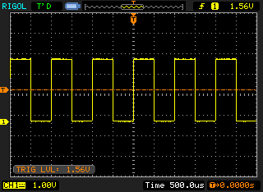

Oscilloscope
Trigger
Turn knob to adjust trigger level
Trigger level should be adjusted within the range of input signal
Press 50% to set trigger level to the centre of the signal

Slide 16
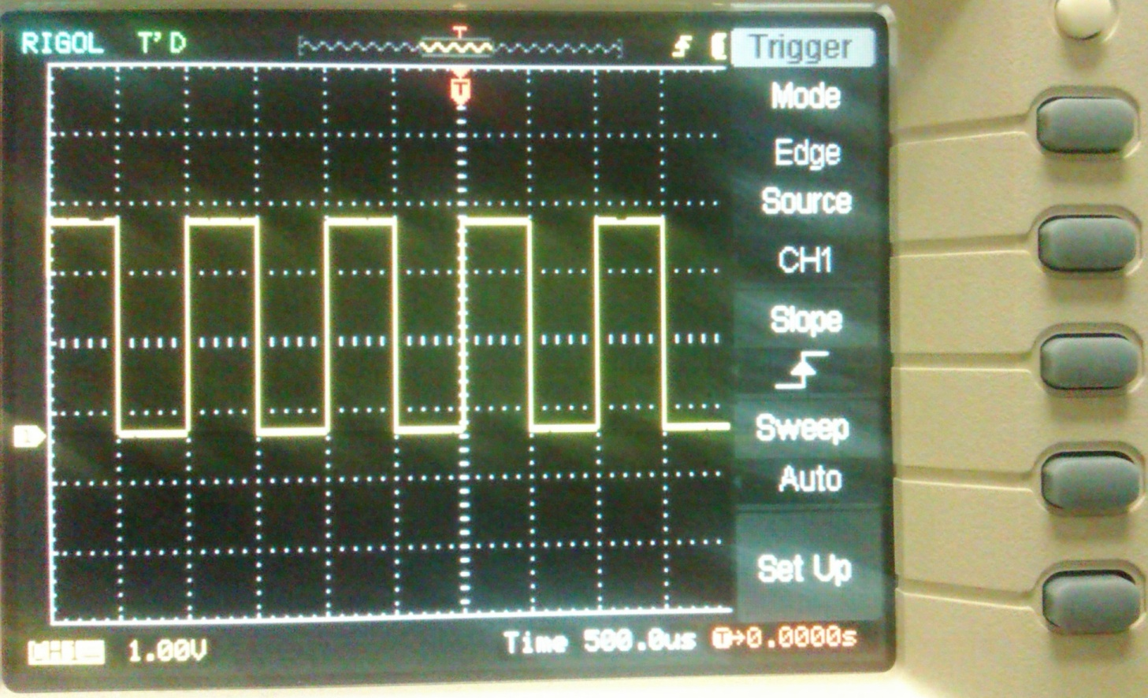

Oscilloscope
Trigger Menu
Mode
Choose edge
Source
Choose CH1/CH2 only (ignore rest)
Slope
Choose rising slope
Sweep
Choose auto
Set Up
Default
Notes:
Select Mode as edge triggered; select input channel as the source; select slope as rising edge,

Slide 17

Oscilloscope
Menu Knob
Measure
Voltage/time properties measurement
Cursor
Coordinates tracking
Menu knob
Status light ON/OFF
Turn to change
Press to confirm

Slide 18
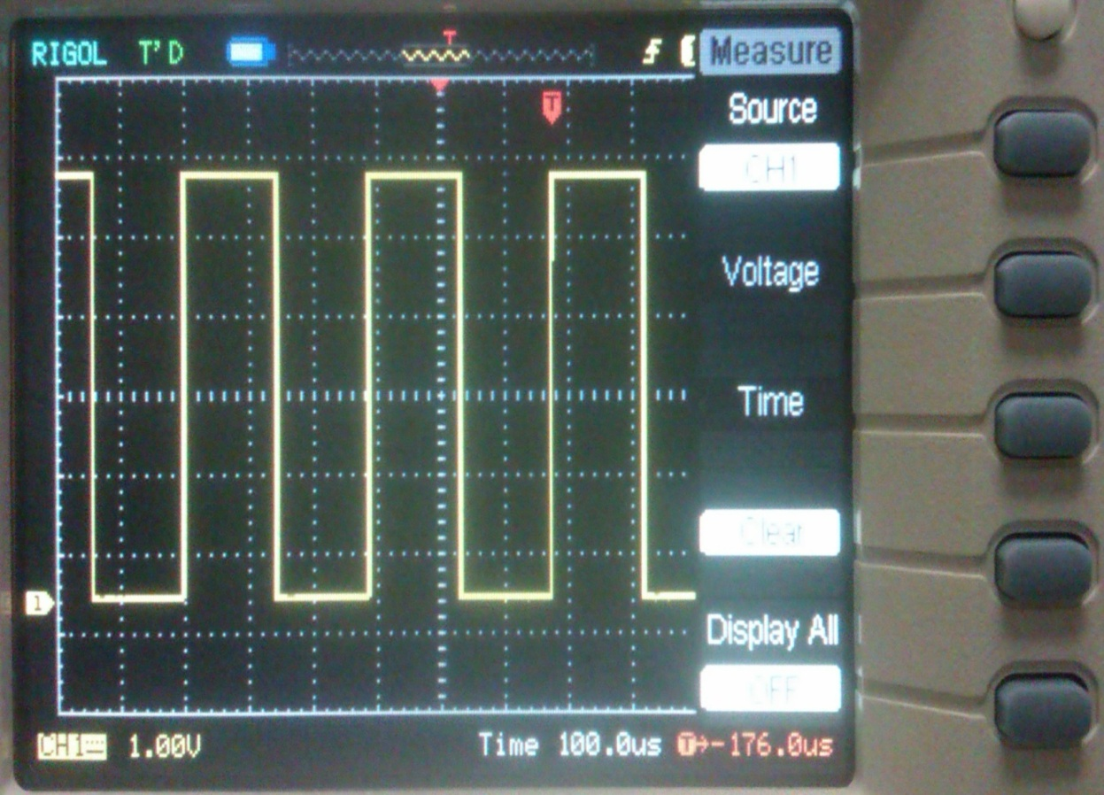

Oscilloscope
Measure Menu
Source
CH1/CH2
Voltage
Vpp, Max, Min, etc
Time
Period, Frequency, etc
Clear
Clear all current measurements
Display all
Display all measurable properties

Slide 19
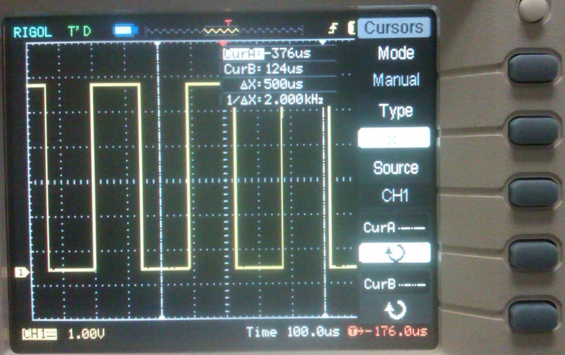

Oscilloscope
Cursor Menu 1
Mode
Manual mode
Type
Tracking on X/Y
Source
CH1/CH2/MATH
CurA
Press button to select/unselect
CurB
Press button to select/unselect
Notes:
Two parallel cursors

Slide 20
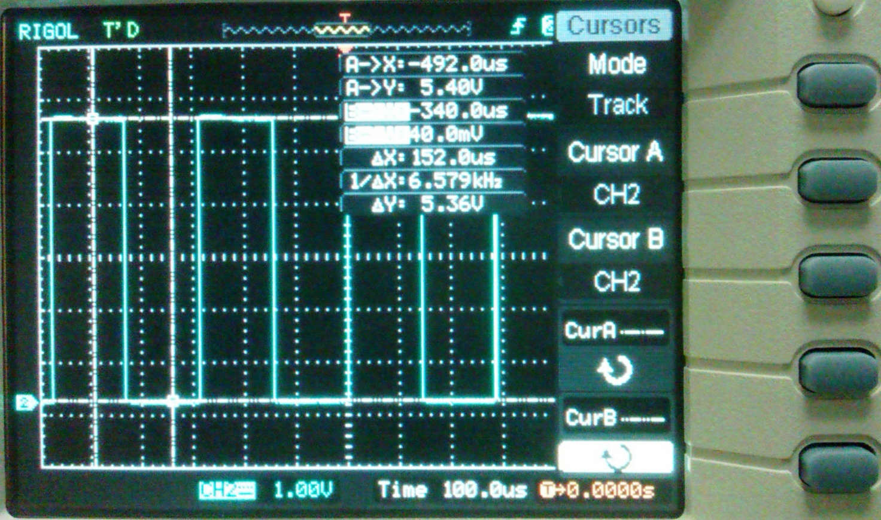

Oscilloscope
Cursor Menu 2
Mode
Track mode
Cursor A
Set cursor A in conjunction with CH1/CH2/MATH
Cursor B
Set cursor B in conjunction with CH1/CH2/MATH
CurA
Press button to select/unselect
CurB
Press button to select/unselect
Notes:
Move together with signals; two cross cursors

Slide 21
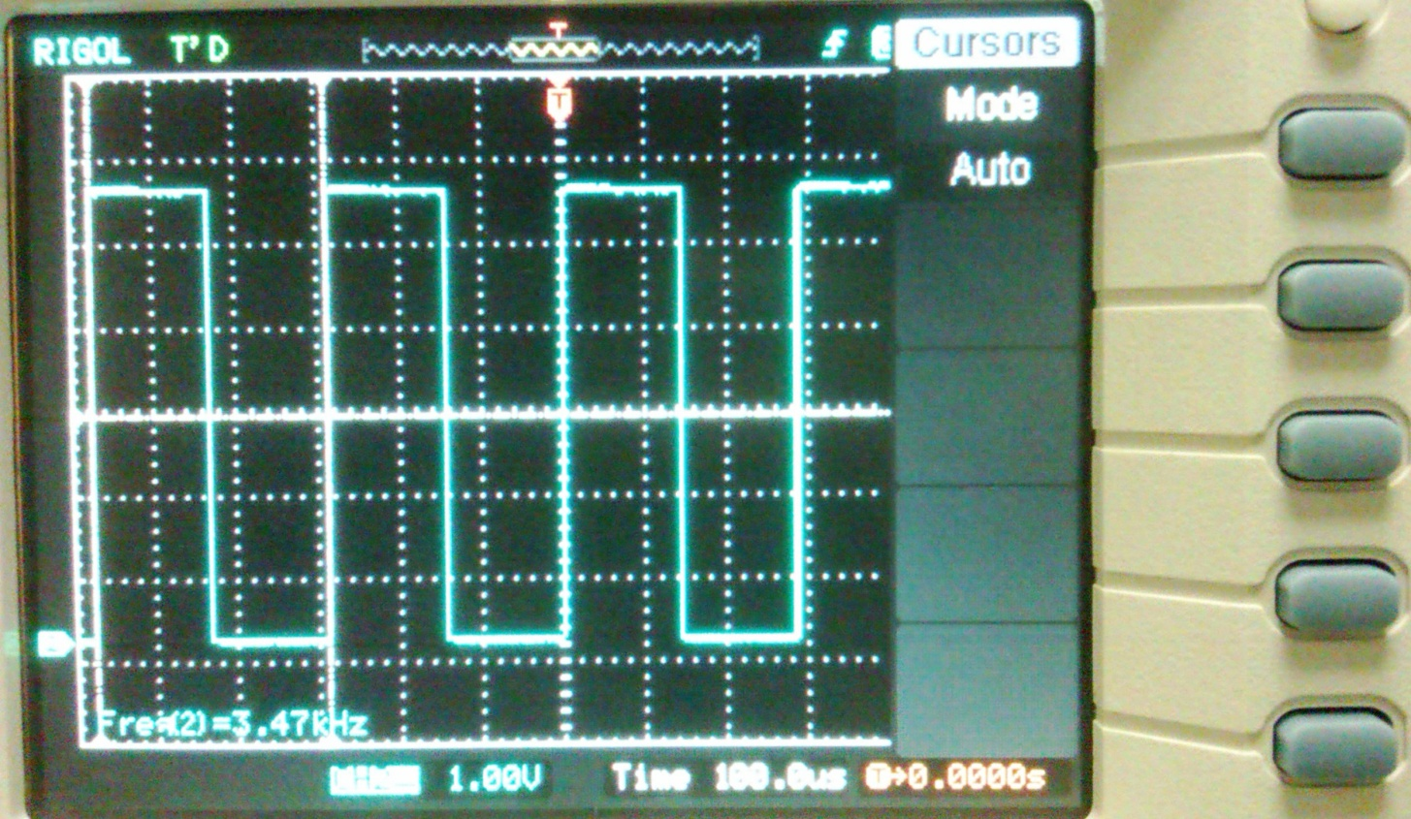

Oscilloscope
Cursor Menu 3
Mode
Auto mode
Display cursor for current measurement
No cursor shown if no parameter selected in Measure mode

Slide 22

Thanks & Enjoy!

